Slide 1
ADVISING STUDENTS
Access these slides at: https://bit.ly/AdvisingStudentsFD22

Slide 2
HELLO!
Lauren Hecht
FTS Director; Psychological Science
lhecht@gustavus.edu
Kate Knutson
Political Science
knutson@gustavus.edu
Slide templates from Slides Carnival

Slide 3
INTRODUCTIONS
Name
Department
How comfortable are you with advising at Gustavus? (1=not at all, 5=very)

Slide 4
1.
THE CURRICULUM

Slide 5
Challenge Curriculum
34 credits total
LAYERING DESIGNATIONS
Rule of Two
Courses can carry up to 2 designations and satisfy both in students’ progress
(limitation: cannot be two of same type - GLAFC & USIDG, WRITL & WRITD, ARTS & HUMN)
Graduation Requirements
12 credits (Challenge Curriculum)
13 credits (Three Crowns)
2 JAN term
4 Writing (1 = WRITL)
1 Quantitative (QUANT)
1 Wellbeing (WELBG)
1 GLAFC
1 USIDG
2 Non-English Language (3 for Three Crowns)
General Education
7 credits
Major Requirements
8-17 credits
CHALLENGE CURRICULUM
FTS
ARTS
HUMN
NTSC
HBSI
THEOL
Challenge Seminar
Electives
all remaining credits
THREE CROWNS CURRICULUM
CUR-100
CUR-115
CUR-125
CUR-215
CUR-255
CUR-260
CUR-399

Slide 6
What Changed?
GRADUATION REQUIREMENTS
Liberal Arts Perspective |  | Challenge Curriculum
32 course credits + 2 Jterm | → | 34 course credits total
IEX (Jterm; 2 courses) | → | JAN (2 courses)
WRITI, WRITD, WRIT_ | → | WRITL & 3 WRIT / WRITL / WRITD courses
MATHL | → | QUANT
FIT & ACT | → | WELBG (1 course)
GLOBL | → | GLAFC & USIDG
Language (200 level or second semester) | → | 2 sequential college-level courses in non-English language

Slide 7
What Changed?
GENERAL EDUCATION
Liberal Arts Perspective |  | Challenge Curriculum
FTS | → | FTS (WRIT)
ARTS | → | ARTSC
LARS | → | HUMN
NASP | → | NTSCI
SOSCI | → | HBSI
THEOL | → | THEOL
n/a | → | Challenge Seminar (capstone course)

Slide 8
2.
ADVISING AND REGISTRATION TOOLS
MyGustavus
& Starfish

Slide 9
Old Terminology → MyGustavus
Degree Audits → Progress
Schedules → Course Plan: Calendar
Four Year Plan → Timeline
Registration → Course Catalog
Course Plan: Calendar
“What if…” major → View a New Program

Slide 10
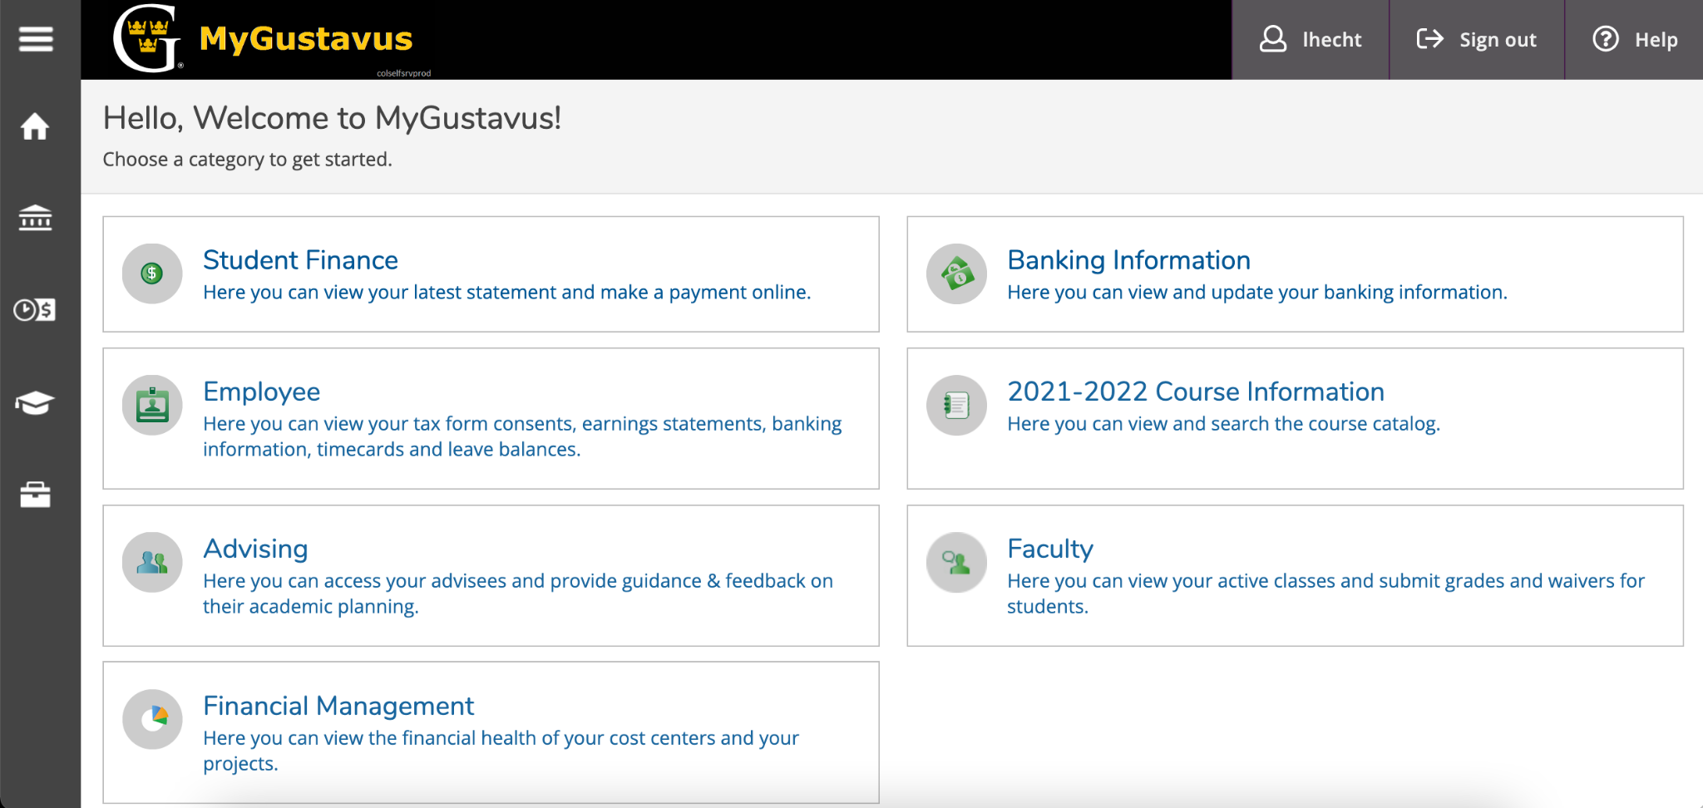
MyGustavus
https://my.gustavus.edu
students use Student Planning

Slide 11
https://my.gustavus.edu
In MyGustavus, pick one of your advisees and…
…view their weekly schedule for this fall
…determine which curriculum they are following (LAP, Three Crowns, CHAL)
…see if they are planning any courses for next semester

Slide 12
What questions do you have right now?

Slide 13
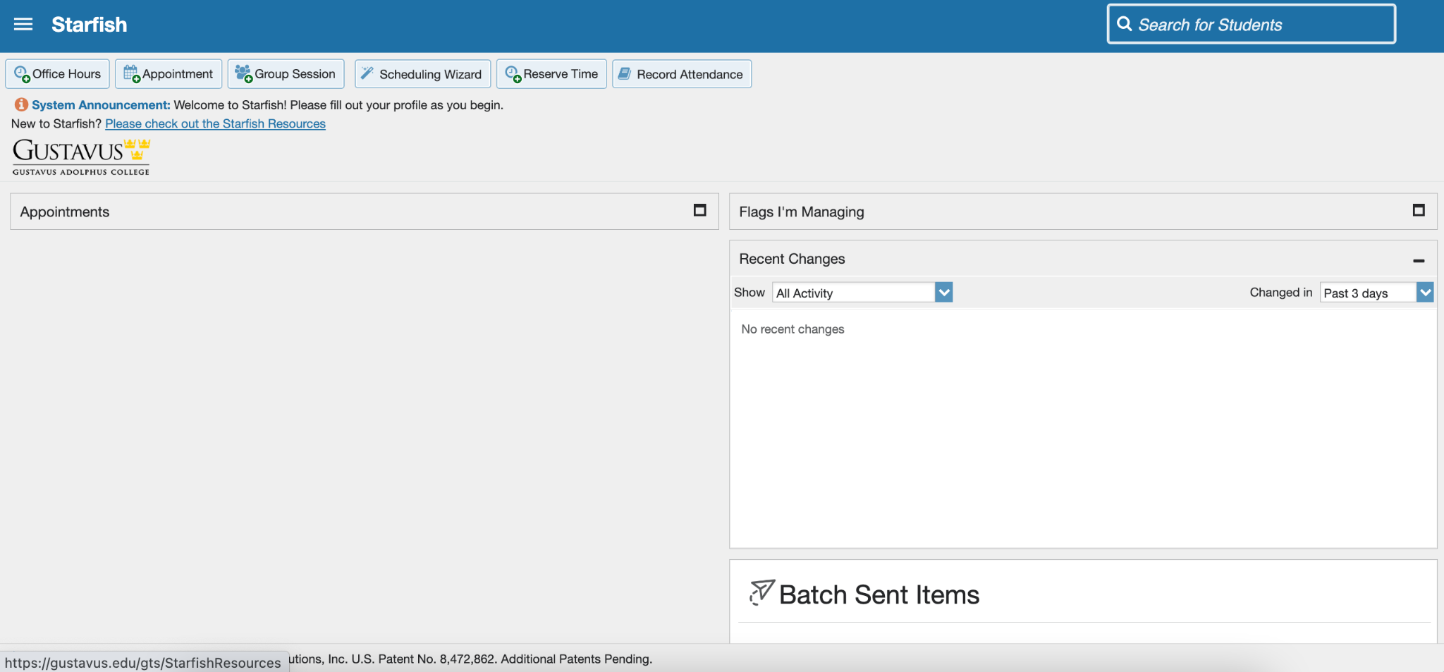
Starfish
https://gustavus.edu/starfish

Slide 14
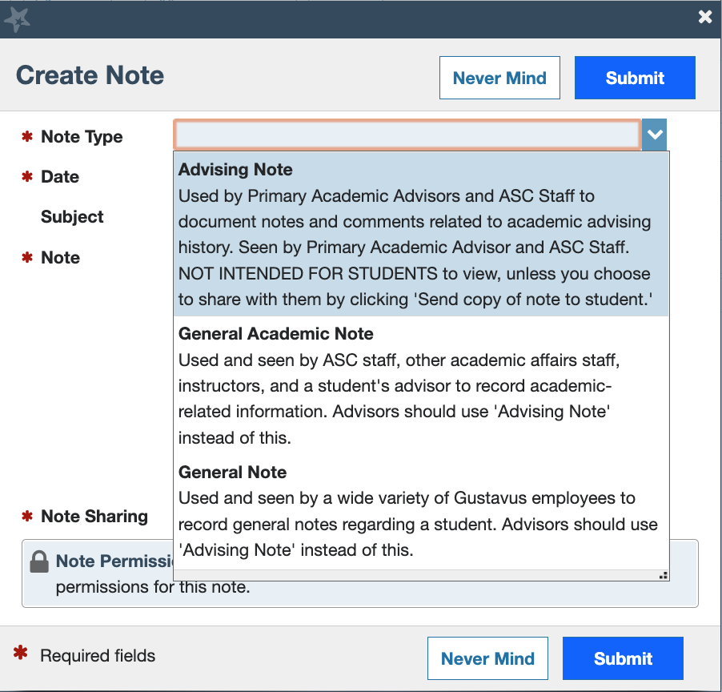
Advising Notes
For academic advisors
Visible by new advisors, unless sharing is set to private
Student MAY get a copy of the note; you choose.

Slide 15
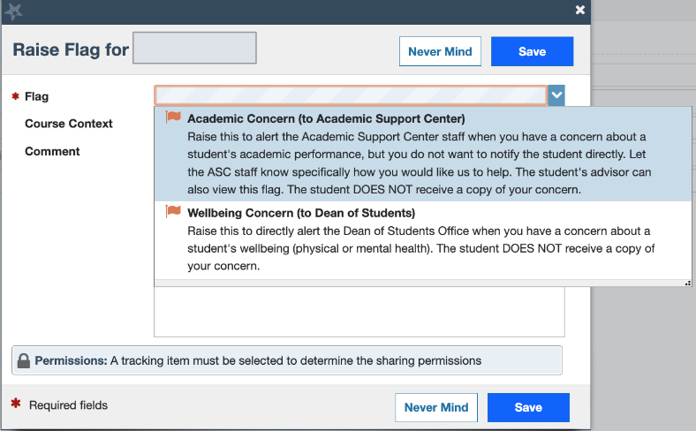
Academic Alert → Raise a Flag
Concerns:
Academic to ASC
Wellbeing to Dean of Students
Student does NOT get a copy of the flag.

Slide 16
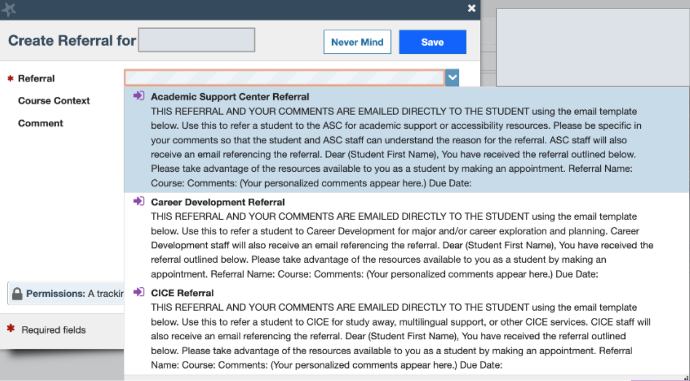
Send a Referral
Offices:
ASC
Career
CICE
Fellowships
Financial Aid
Library
Student DOES get a copy of the referral.

Slide 17
https://gustavus.edu/starfish
Open Starfish. Look through 5 of your students. Did any of them…
…have an Advising Note?
…identify as a first-generation student?
…academic standing? …have a registration hold?
…have flags or referrals?

Slide 18
What questions do you have right now?

Slide 19
3.
THE ADVISING PROCESS
Establish, Practice, And/Or Refine

Slide 20
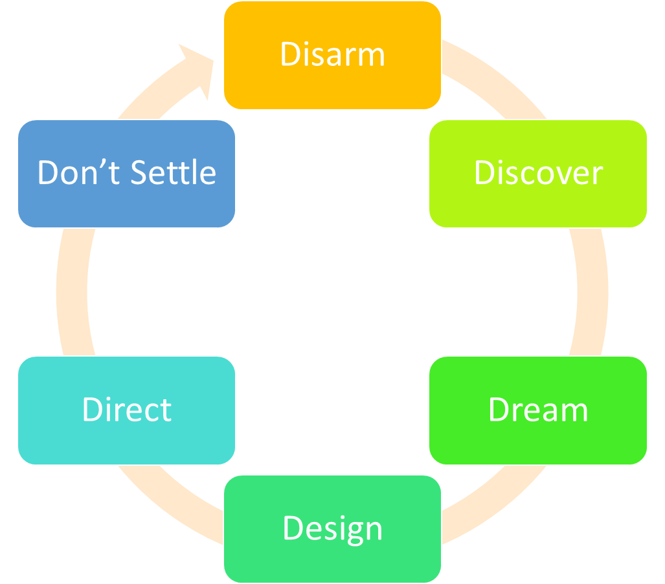
APPRECIATIVE ADVISING

Slide 21
ROLE PLAYING
Scenario #1: You agree to advise a first-year undeclared student whose advisor is on leave in spring.
Scenario #2: You just agreed to be major advisor for a transfer student with junior status.

Slide 22
Scenario #3: You’ve become major advisor for a student behind on credits and on an academic sanction.
Scenario #4: You’re still advising a second-year undeclared advisee waiting for acceptance into a major with an application procedure.

Slide 23
What questions do you have right now?

Slide 24
4.
RESOURCES

Slide 25
Sample Progress Reports:
Meykaya Happy
Neerin Theend
Stu Dent
Coll Edge (there is an intentional error on this one)

Slide 26
Advising & Registration Tools
Advising & Registration Manual (ARM)
Faculty Advising Resources
Academic Bulletin / Course Catalog
Office of Health Professions
Creating Your Four-year Plan (to share with students)
Notes:
ASC - Creating Your Four-year plan (share with students)

