Slide 1
What is trauma and why it matters?
Joy von Steiger, PhD

Slide 2
What is trauma?
Trauma is the result of an event, series of events or sets circumstances experienced by a person that has the potential to affect them physically or emotionally; in the event of a life threatening event might affect them cognitively, physically, socially, emotionally or spiritually.
-SAMHSA, 2014

Slide 3
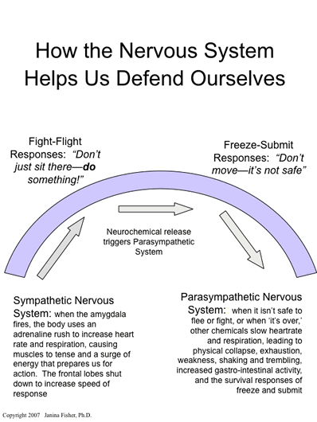

Slide 4
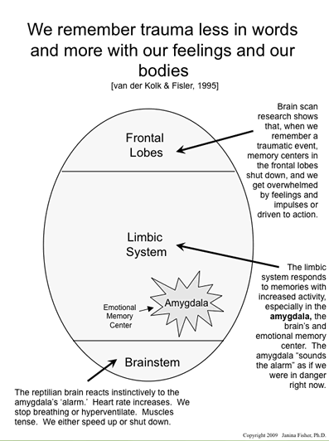

Slide 5
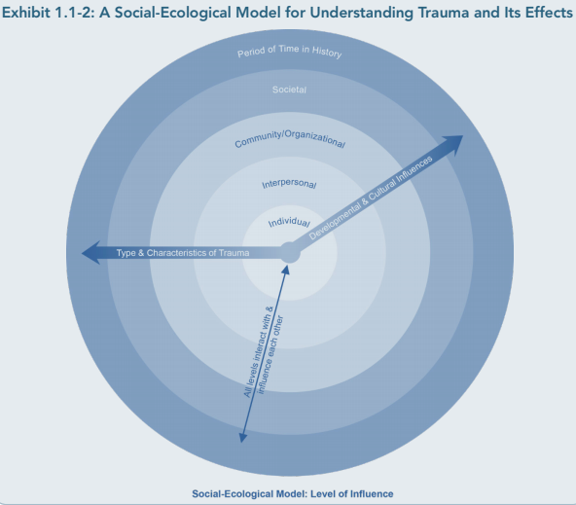

Slide 6
Psychological First Aid
Human compassionate non-intrusive connection
Establish safety and reduce distress
Provide a calming and orienting presence
Ask people what they need
Connect people to supports
Support adaptive coping which is different for everyone
Do not ask people to process the trauma
Take care of yourself and remember that you too need support

Slide 7
Macro and Micro Traumatic Events
66-85% of college students report being exposed to a lifetime traumatic event ( Read, Ouimette, White, Colder and Farrow, 2011)
18-24 yr old females experience highest rate of sexual assault than other age groups (Sinozich and Langton, 2014)
Up to 50% of college students experience traumatic event in first year of school
Students with prior trauma are more susceptible to effects of subsequent trauma

Slide 8
Recognizing Trauma in the classroom
Difficulty focusing or attending
Missing multiple classes
Difficulty regulating emotions
Afraid of trying new things
Anxiety about deadlines, exams or presentations
Anger or dissociation when stressed
Withdrawal or isolation

Slide 9
What is trauma informed pedagogy?
Empower students to make choices and care for themselves
Express unconditional positive regard from first meeting onward
Maintain high expectations
Make observations and ask questions rather than make assumptions
Help students develop positive relationships
Be trustworthy, reliable, and clear about expectations
Have clear boundaries
Do not expect students to talk about trauma past or present
Maintain structure of classroom and allow students to choose when exceptions are made

Slide 10
The importance of self reflection and self care
Being open to another’s suffering takes courage
Be aware of compassion fatigue, vicarious trauma or retraumatization
Be aware of when your own trauma is surfacing
Mindfulness can not only help your students but help you to stay present and calm
Don’t worry alone
Rely on community to support one another while being cognizant of student confidentiality

Slide 11
Compassion Fatigue
Difficulty talking about feelings
Jumpiness, irritability, blaming
Worrying you’re not doing enough
Trouble sleeping and/or nightmares
Change in eating patterns
Reduced satisfaction in pleasurable activities and/or work
Feeling hopeless about work
Intrusive thoughts of traumatic experiences or student’s stories

